Slide 1
Elementary Scheduling w/Excel: Admin Choice for Specials
Bob Cornacchioli DERO Technical Services
bcornacchioli@gmail.com
get2bobc@gmail.com
www.derotechnical.com

Slide 2
Agenda/Participants will be engaged in:
Courses – Sections = WHAT
Teacher Numbers = WHO
Rooms = WHERE
Days – EXPRESSIONS – Periods & Term ID = WHEN
Dependent Sections
EOY – Mass Enroll
44 slides in 50 minutes
www.derotechnical.com for more resources

Slide 3
CEO - DERO Technical Service Marketing/ - ParkBench Software
Trainer
Director of Technology and Media Services Shrewsbury Public Schools (16 yrs) PowerSchool Administrator (6 yrs)
PSISJS Partner – Standards/Trainer (2013)
Featured Instructor – PowerSchool EDGE (2020)
Alpha/Beta Team for and PTP
Bob Cornacchioli

Slide 4
Who are you?
What is your role/title
Have you ever scheduled a school?
Did you copy your master and tweak/reimport?
Did you use Excel?
How many elementary schools are in your district?
Split or combo classes?

Slide 5
What do you have now?
DRAW A LINE IN THE SAND
What format?

Slide 6
Or this?

Slide 7
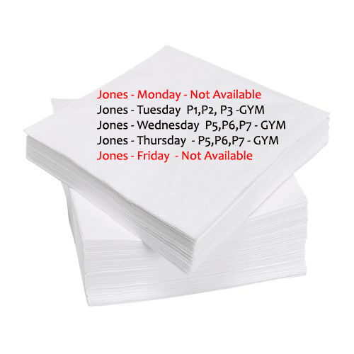
Never this I hope – I did!
Is it worth learning a new method?

Slide 8
Thought I would send you an UPDATE
3 years later I thought I would let you know I am still using the tool you provided to me to successfully and quickly setup my school for the new year. Thanks again Bob!
Every time I use this spread sheet of yours to upload my elementary Master Schedule it just makes my freaking day!
David Moon,
Technology Director,
Sultan School District,
Sultan, WA

Slide 9
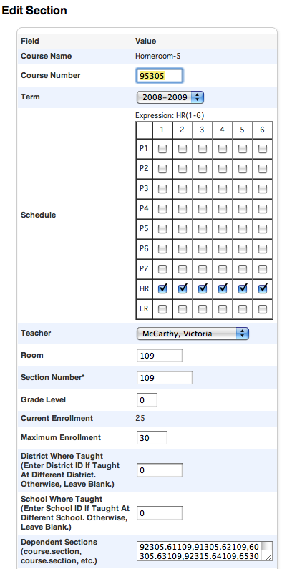
Convert it to this!
Course Name
Course Number
Term Length
Expression- When does it meet?
HR(1-6) would place a √ for each day
Teacher
Room – Where does it meet?
Grade Level – N/A
Section Number- VIP!!! Plenty of ideas here!!
Max Enrollment
Dependent Sections- If enrolled in this class students would also get these courses
WHAT
WHEN
Why would I show you
2008-2009
WHO
WHERE
Slight difference – co-teaching later!

Slide 10
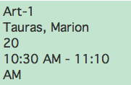
Dependent Sections
PS NEEDS:
WHAT
WHO
WHERE
WHEN
Gray means w/HR Teacher
P
E
R
I
O
D
S
3(C)
3(E)
7(A)
8(B), 7(D)

Slide 11
Does your state require to report grades by class…
at the elementary school?
If NO – this will impact the courses you can associate standards?
If YES – how does your district define ELA?

Slide 12
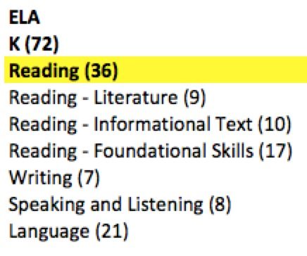
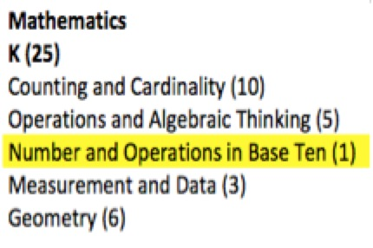
Should Common Core Standards Impact Scheduling?
How many courses are you
planning to use for
English Language Arts? Reading – Writing Speaking & Listening - Language

Slide 13
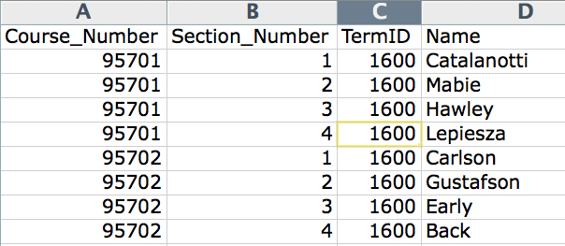
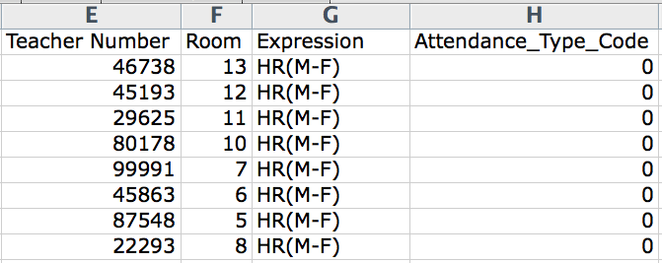
WHERE
WHEN
WHAT
WHO
Scheduling Spreadsheet

Slide 14
It’s essential you understand the importance of each column and its interdependency on others and your final schedule. In this screenshot above, this represents only 2 teachers. Understanding the columns.
Column A, B, E, G have DNU after the column name = DO NOT USE/IMPORT
Columns K, L, M,N normally do not change from year to year. (BLUE)
Columns E and O are auto generated by a concatenation equation. Enter data correctly in Column C and D and E and O are auto-generated.
Column F (GREEN) will have to be changed ANNUALLY. Next year is 2019-2020 but it has to be 2900 in PS. Why 2900 – it’s the 29th year of PS Scheduling.
Columns G, H, I all relate to the teacher and where he or she teaches – Teacher Name – DNU, TeacherNumber and Room. These may not change much per year. Column J is the expression – when that class actually meets.
Dependent Sections (Column O) – the only course that has dependent sections is Homeroom. That is why all the other courses have that column BLANK. It’s autogenerated.

Slide 15
Term ID’s for Less than Full Year Courses!
Full Year Course = 2300
T1 =2301, T2=2302, T3=2303
C1=2304, C2=2305, C3=2306, C4=2307, C5=2308, C6=2309
This year is?
Next year will be?

Slide 16
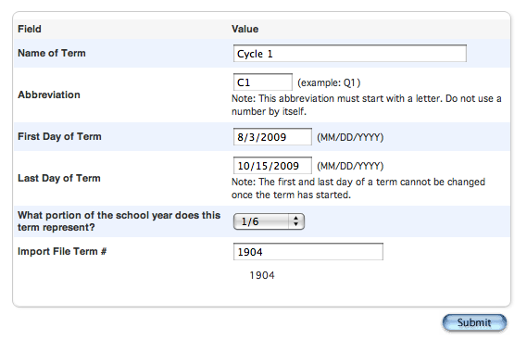
If you are importing – double √√√
Your numbers have to match
Full Year Course = 2300
T1 =2301, T2=2302, T3=2303
C1=2304, C2=2305, C3=2306, C4=2307, C5=2308, C6=2309

Slide 17
Don’t want to start from scratch!
[5]lastfirst
[5]title
[5]teachernumber
[5]status
[5]last_name
[5]first_name
SchoolID
[2]course_name
Course_Number
Dependent_Secs
Expression
^(*class_expression data="abbr" format="expression")
Grade_Level
Section_Number
Team
TermID
Attendance_Type_Code
Att_Mode_Code
Room
( I think it’s easier from scratch)
Got DDE Experience?
Then Export from the Sections (3) table
Select from this school only
Filter Term ID >= 2900 (for this year)
RED - export but DNU
BLUE - update for next year
ORANGE – rename to Expression to reimport
http://www.derotechnical.com/SCHEDULING/Scheduling.html

Slide 18
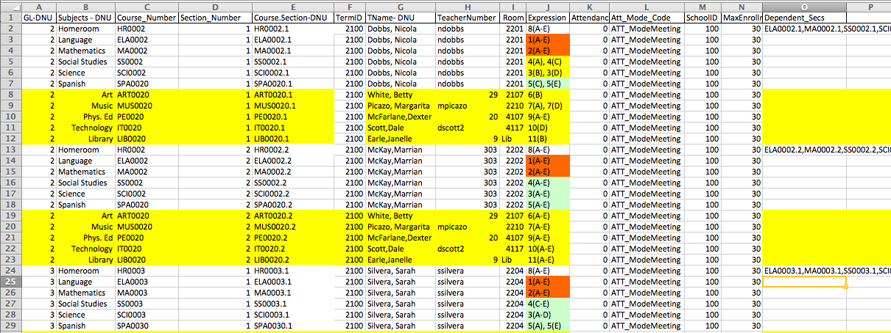
Excel Import File Must Be Converted
WHEN
WHAT
DNU- DO NOT IMPORT
Visual Clues
WHO
WHERE
Dependent Sections REQUIRES course.section,course.section,course.section
You can manually enter them OR….

Slide 19
Excellent with Excel?
Course.Section=CONCATENATE(C3,".",D3)
Dependency=course.section,course.section etc
=CONCATENATE(E4,",",E5,",",E6,",",E7,",",E8,",",E9,",",E10,",",E11,",",E12)
http://www.derotechnical.com/SCHEDULING/Scheduling.html
Culture Club’s - Karma Chameleon
,”,”, ,”,”, ,”,”, ,”,”,

Slide 20
Depend Sections – depend_secs
Dependency=course.section,course.section, etc

Slide 21
WHAT
WHEN
WHO
WHERE
WHEN
NORMAL ELEMENTARY SCHEDULE....
HR Teacher appears on the spreadsheet 5 times - HR, ELA, MA, SS, SCI
Below list all the special subjects that his or her students take with other teachers
Once one HR teacher and his/her core subjects and specials are listed, copy/paste/change for teacher #2 for that same grade level. Repeat until all HR teachers for that grade level are complete

Slide 22
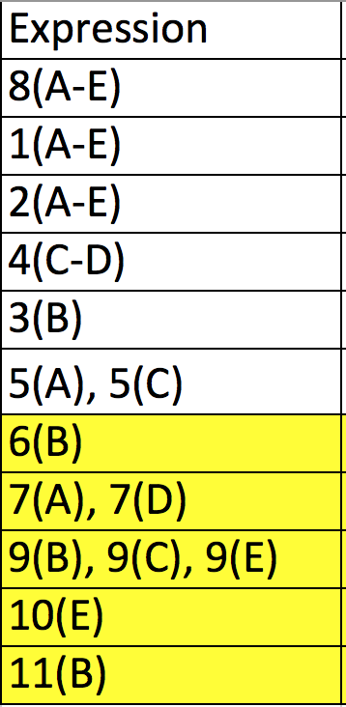
Expressions Period(Days) PRINT THIS PAGE
Days Monday = A
Tuesday = B
Wednesday = C
Thursday = D
Friday = E
Periods
1
2
3
4
5
6
7
8
9
10
11
Rules for Expressions
Contiguous Days use a DASH
(A-E) (A-C) (A-B)
Single Meeting Date
Period(Day)
Multiple meetings per week
Non-contiguous
Expression, SPACE Expression
5(A), 5(C)
9(B), 9(C), 9(E) or
9(B-C), 9(E)
Bell Schedule sets the time of these periods. If you need more periods that is done under Years and Terms

Slide 24
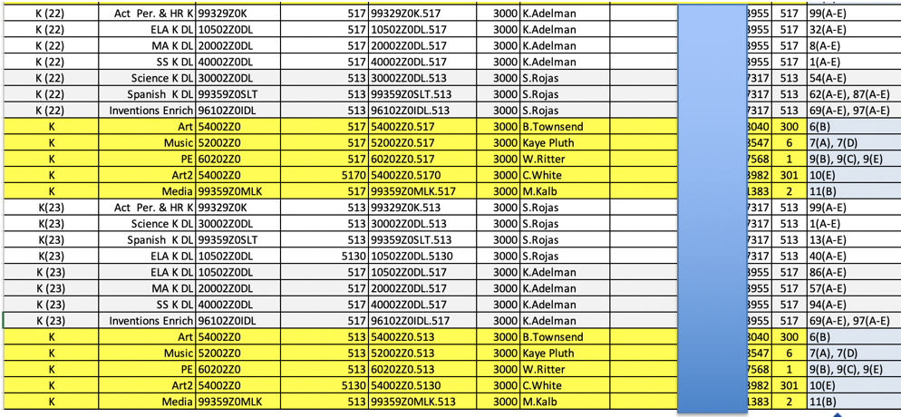
Split Classes – Core to two locations

Slide 25
Dependent Section Options
HR >> ELA, MA, SCI, SS and SPECIALS if the students travel to ART, MUSIC, PE, HEALTH etc as a HR Group
If students go to SPECIALS as a new group other than HR but stay together as a group in these elective subjects then…
PE>> ART, MUSIC, HEALTH, LIBRARY
( upper elementary & MS Schools)

Slide 26
Best Practices – READY.txt

Slide 27
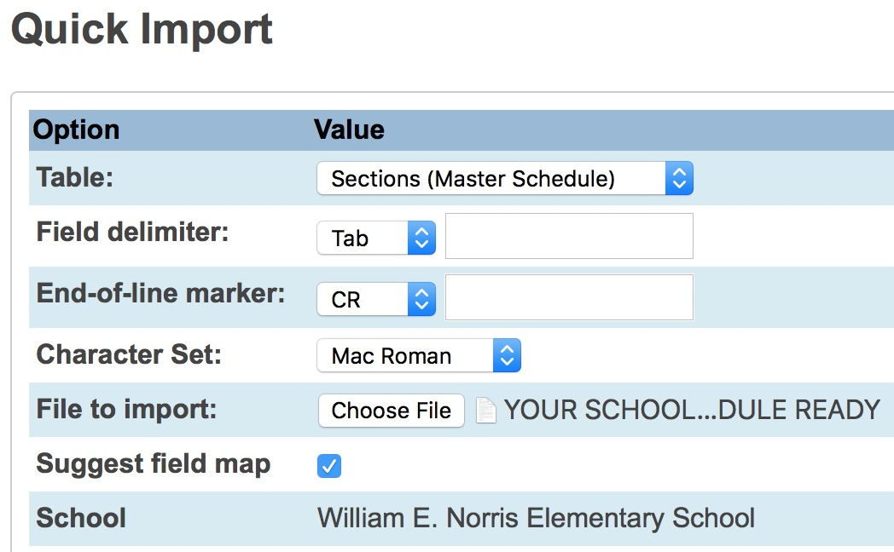
Importing Schedule into PowerSchool
( this can only be done once the years and terms for next year have been created already!)
Convert XLS to TEXT File (READY)
Special Functions
Importing and Exporting
Quick Import
Table- Sections (Master Schedule)
Find TXT file READY ( converted XLS file )
Match column names to those in PS

Slide 28
Import into the Sections (Master Schedule)
Never REMOVE √

Slide 29
Suggested Field Map
√
Removes Column Headers that were used in Excel
Name is not used in PS, but I use it as a visual clue.
Do you know your teacher numbers?
ANY File Headers in EXCEL on LEFT with DNU will not match
PS Fields on Right.

Slide 30
After Import – RED is BAD!
After importing PowerSchool displays a page with your results.
RED is an error and it “clearly” tells you ( HA!) what these mean. Go slow it’s doable
Typical Errors:
Bad teacher numbers
Expression is wrong
Term ID is wrong/not set

Slide 31
Mass Enroll Function
AFTER EOY AFTER EOY AFTER EOY
Course.Section this identifies your teachers/rooms and periods
Enrollment Date – NORMALLY first day of school .
This date is always the date of your action, you must change it!

Slide 32
Let’s download the template and play!!
1 School per spreadsheet Let’s complete one teacher in lowest grade
Remember – WHO WHAT WHERE AND WHEN

Slide 33
Q & A
ANY AND ALL DERO RESOURCES ARE AVAILABLE
TO DOWNLOAD, TWEAK and USE FOR YOUR DISTRICT!
Bob Cornacchioli DERO Technical Services
bcornacchioli@gmail.com
get2bobc@gmail.com
www.derotechnical.com

